Slide 1
Keeping Your Apps Safe: Understanding Broken Access Control
A Simple Guide to Broken Access Control in OWASP Top 10
Siddharth Biju

Slide 2

1. Introduction to API
1.1 Definition of API
Definition: A set of rules and protocols that allows different software applications to communicate with each other.
Examples: RESTful APIs, SOAP APIs.

Slide 3
Demo

Slide 4
2. What is OWASP Top 10?
2.1 Overview
OWASP (Open Web Application Security Project):
Introduction: A non-profit organization focused on improving software security.
OWASP Top 10:
Definition: A regularly updated report outlining the most critical security risks to web applications.

Slide 5
OWASP TOP 10
Top 10 Web Application Security Risks
A01:2021-Broken Access Control
A02:2021-Cryptographic Failures
A03:2021-Injection
A04:2021-Insecure Design
A05:2021-Security Misconfiguration
A06:2021-Vulnerable and Outdated Components
A07:2021-Identification and Authentication Failures
A08:2021-Software and Data Integrity Failures
A09:2021-Security Logging and Monitoring Failures
A10:2021-Server-Side Request Forgery

Slide 6
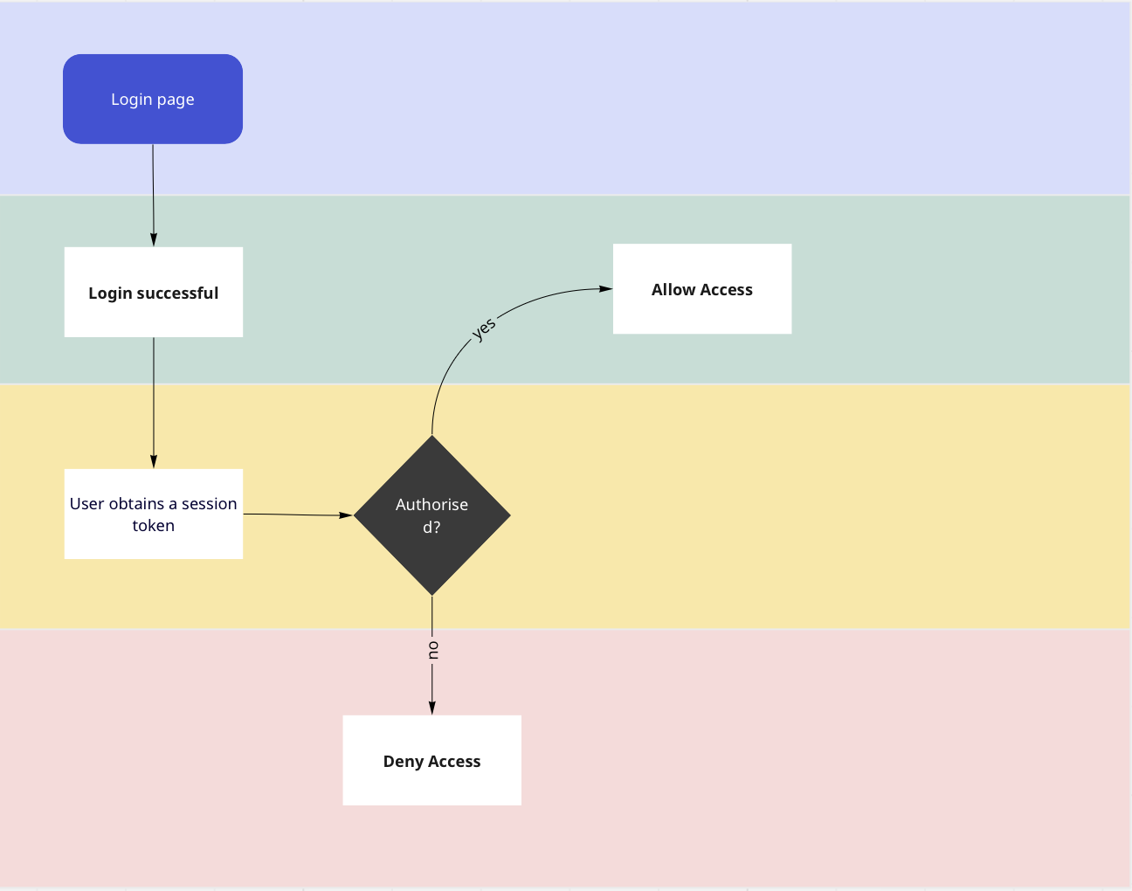
Authentication Flow

Slide 7
Broken Access Control
A Critical OWASP Top 10 Security Risk
Definition: Broken Access Control refers to inadequate restrictions on authenticated users, allowing unauthorized access to sensitive data or functionalities.
Importance: Proper access control is crucial for preventing unauthorized actions and maintaining data confidentiality.

Slide 8
Forced Browsing
Unauthorized Access Through URL Manipulation
Definition: Forced Browsing occurs when an attacker accesses restricted resources by manipulating URLs, bypassing proper authorization.
Example: A user might change parameters in the URL to access another user's profile or sensitive documents.

Slide 9
Demo

Slide 10
Insecure Direct Object References (IDOR)
Unauthorized Object Access Exploitation
Definition: IDOR allows attackers to access and manipulate objects (files, database records) they aren't authorized to access directly.
Example: An attacker changing a parameter in a URL to access another user's private document.

Slide 11
Demo

Slide 12
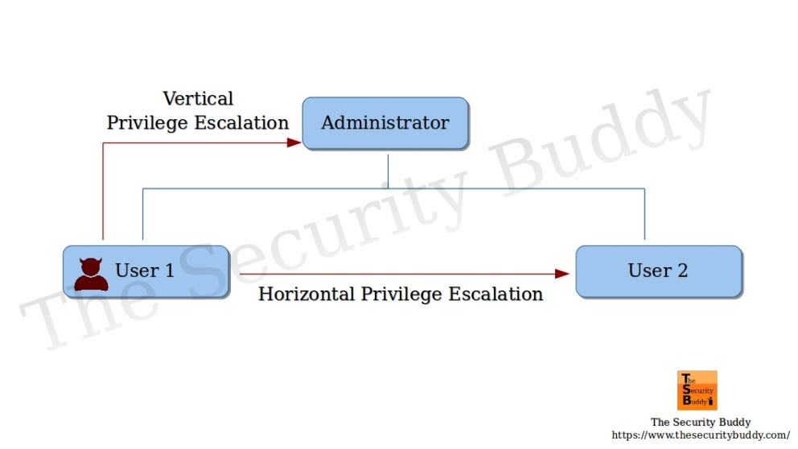
Horizontal and Vertical Privilege Escalations

Slide 13
Horizontal Privilege Escalation
Unauthorized Access Within the Same Privilege Level
Definition: Horizontal Privilege Escalation lets attackers gain unauthorized access to data belonging to another user with the same privilege level.
Example: An attacker exploiting a vulnerability to access another user's data within the same role or privilege level.

Slide 14
Demo

Slide 15
Vertical Privilege Escalation
Unauthorized Access to Higher Privilege Levels
Definition: Vertical Privilege Escalation allows attackers to gain unauthorized access to data or functionalities belonging to a user with higher privilege.
Example: An attacker exploiting a vulnerability to gain administrative access, escalating their privileges.

Slide 16
Demo

Slide 17
Understanding JWT Modification
Risks and Implications in Web App Security
Compact means of representing claims for authentication in web apps.
JWT Structure: Header, Payload, Signature (modifiable claims in Payload).
Risks: Unauthorized modifications, tampering with roles and privileges.
Attack Vectors: Intercepting and altering tokens, exploiting generation/validation vulnerabilities.
Implications: Affects authentication, authorization, and data integrity.
Prevention: Strong encryption, key management, and robust token validation.
Examples: Brief real-world incidents and lessons learned.
Best Practices: Adhere to standards, implement secure JWT practices.
Conclusion: Emphasize need for vigilance and proactive security measures.

Slide 18
Demo

Slide 19
CORS Misconfigurations
CORS & Security
Definition: CORS controls web app requests to different domains.
Risks: Misconfigurations lead to vulnerabilities.
Impact: Unauthorized domains accessing data.
Common Issues: Overly permissive origins, missing headers.
Mitigation: Set proper headers, restrict origins, use credentials wisely.
Importance: Crucial for preventing cross-origin threats.
Best Practices: Follow security guidelines, audit CORS settings.
Conclusion: Stress the need for correct CORS configuration.

Slide 20
Example

Slide 21
Mitigating Broken Access Control
Strategies for Secure Access Management
Proper Access Controls: Implement robust access control mechanisms, ensuring users only have access to resources they're authorized to use.
Role-Based Access Control (RBAC): Utilize RBAC to assign permissions based on user roles, reducing the risk of unauthorized access.

Slide 22
Testing Guide - Explore Further Resources
Enhance Your Security Testing Practices
https://owasp.org/www-project-top-ten/
https://owasp.org/www-project-web-security-testing-guide/v42/4-Web_Application_Security_Testing/05-Authorization_Testing/02-Testing_for_Bypassing_Authorization_Schema
https://owasp.org/www-project-web-security-testing-guide/latest/4-Web_Application_Security_Testing/06-Session_Management_Testing/10-Testing_JSON_Web_Tokens
https://owasp.org/www-project-web-security-testing-guide/v41/4-Web_Application_Security_Testing/11-Client_Side_Testing/07-Testing_Cross_Origin_Resource_Sharing
https://owasp.org/www-project-web-security-testing-guide/latest/4-Web_Application_Security_Testing/05-Authorization_Testing/04-Testing_for_Insecure_Direct_Object_References

Slide 23
Conclusion
Prioritizing and Addressing Security Risks
Explored the concept of privilege escalation, understanding both horizontal and vertical scenarios.
Identified vulnerabilities like forced browsing and Insecure Direct Object References (IDOR) within the Broken Access Control context.
Tomorrow's Focus: Injection – a critical topic that involves manipulating data inputs to compromise the integrity of a system.

